Slide 1
DETECTING, CHARACTERIZING, AND TAMING FLAKY TESTS
Wing Lam
George Mason University

Slide 2
Agenda
Quiz 4 (please be sure to put your name exactly as it appears on Blackboard -- first name(s) then last name(s), you will lose points otherwise)
Finish lecture on detecting flaky tests
15min break
Lecture on taming flaky tests
Introduce Assignment 4
https://cs.gmu.edu/~winglam/classes/637/assigns/assign04.html

Slide 3


Preempting OD Tests
Preempting OD tests: proactively detecting OD-test failures
Main ways to help developers preempt OD tests:
Run many test-suite orders
All possible test orders
Randomly sample test orders
Systematically pick a subset of orders to run
Using dynamic information
Using static information
Detect tests that may become OD, even if they are currently not
For a test suite with just 5 tests:
Prohibitively expensive for most
T1:
test₀
test₁
test₂
test₃
test₄
T2:
test₁
test₀
test₂
test₃
test₄
Lightweight but may miss OD tests
…
T120:
test₄
test₃
test₂
test₁
test₀
Can contain many false positives

Slide 4
Importance of Pairs for OD Test Detection
A victim fails when polluters are run before victim, unless cleaners are run inbetween them; all other tests do not affect victim’s result
Consider example of a victim V that has 1 polluter and 1 cleaner; possible orders:
P
C
V
C
V
P
V
P
C
V
C
P
P
V
C
C
P
V
Prior work¹ has found that polluters are almost always just 1 test, not multiple tests
=>To detect OD tests, we can simply run all pairs of tests consecutively!
4
¹Shi et al. “iFixFlakies: A Framework for Automatically Fixing Order-Dependent Flaky Tests”. ESEC/FSE 2019

Slide 5
Tuscan Squares¹ Combinatorial Design
An r x n Tuscan-k rectangle has r rows and n columns
each row is a permutation of the n different symbols
for any two distinct symbols a and b, and for each m from 1 to k, there is one row in which b is m steps to the right of a
If r = n and k = 1 these are referred to as Tuscan squares.
=> Tuscan squares can generate orders to run all pairs
¹Golomb et al. 1985. Tuscan squares – A new family of combinatorial designs. Ars Combinatoria 20, B (1985).

Slide 6
Tuscan Square Examples to Cover All Pairs
For a test suite with just 2 tests:
All n! orders
Tuscan Square orders
T1:
test₀
test₁
T1:
test₀
test₁
T2:
test₁
test₀
T2:
test₁
test₀
For a test suite with just 4 tests:
All n! orders
Tuscan Square orders
Notes:
Discuss example for what 3 tests would be like for n! and Tuscan square

Slide 7
In-class exercise
For a test suite with just 2 tests:
All n! orders
Tuscan Square orders
T1:
test₀
test₁
T1:
test₀
test₁
T2:
test₁
test₀
T2:
test₁
test₀
For a test suite with just 4 tests:
All n! orders
Tuscan Square orders
What are the test orders you would need?
How many of those orders do you actually need to make sure all test pairs are run right next to each other?

Slide 8
Tuscan Square Examples to Cover All Pairs
For a test suite with just 2 tests:
All n! orders
Tuscan Square orders
T1:
test₀
test₁
T1:
test₀
test₁
T2:
test₁
test₀
T2:
test₁
test₀
For a test suite with just 4 tests:
All n! orders
Tuscan Square orders
T1:
test₀
test₁
test₂
test₃
T1:
test₀
test₃
test₁
test₂
T2:
test₁
test₀
test₂
test₃
T2:
test₁
test₀
test₂
test₃
…
T3:
test₂
test₁
test₃
test₀
T24:
test₃
test₂
test₁
test₀
T4:
test₃
test₂
test₀
test₁
=>We may not need to run all pairs…

Slide 9
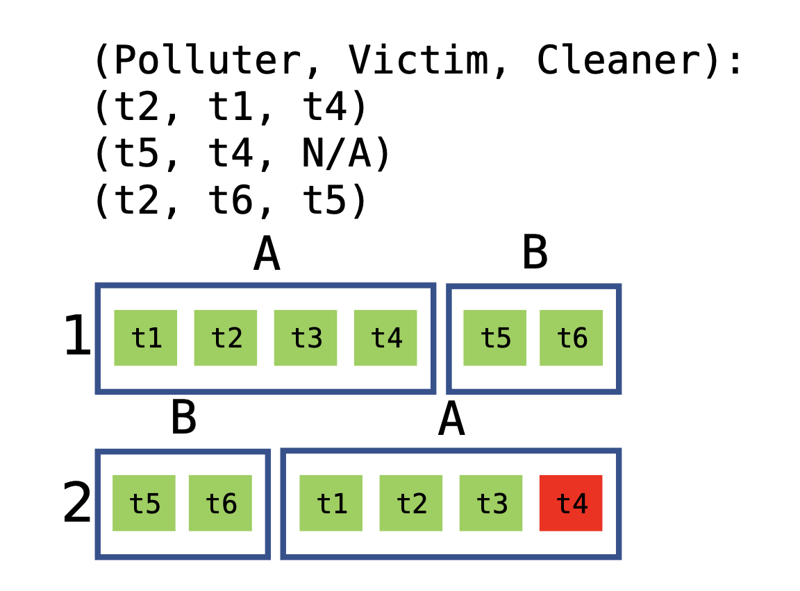
Technique 1: Tuscan Class-Only⁴
For 2 test classes:
Produce test orders that cover all test-class pairs, ignoring tests inside test classes
⁴Wei et al. “Probabilistic and systematic coverage of consecutive test-method pairs for detecting order-dependent flaky tests.” TACAS 2021.

Slide 10


Technique 1: Tuscan Class-Only
For 6 tests in 2 test classes:
Produce test orders that cover all test-class pairs, ignoring tests inside test classes
Runs 2 orders

Slide 11
Technique 2: Tuscan Intra-Class
For 6 tests in 2 test classes:
Produce test orders that cover all test-class pairs, and test pairs inside each test class
A
B
t1
t4
t2
t3
t5
t6
B
A
t6
t5
t2
t1
t3
t4
t1
t4
t2
t3
t5
t6
B
A
B
t2
t1
t3
t4
t6
t5
t3
t2
t4
t1
t5
t6
A
B
A
t3
t2
t4
t1
A
B
t6
t5
t4
t3
t1
t2
t4
t3
t1
t2
B
A

Slide 12
In-class exercise
For 6 tests in 2 test classes:
Produce test orders that cover all test-class pairs, and test pairs inside each test class
A
B
t1
t4
t2
t3
t5
t6
B
A
t6
t5
t2
t1
t3
t4
t1
t4
t2
t3
t5
t6
What are the test orders that
would be generated?
Which victims would these orders be able to detect?
B
A
B
t2
t1
t3
t4
t6
t5
t3
t2
t4
t1
t5
t6
A
t3
t2
t4
t1
A
B
t4
t3
t1
t2
B
A

Slide 13
Technique 2: Tuscan Intra-Class
For 6 tests in 2 test classes:
Produce test orders that cover all test-class pairs, and test pairs inside each test class
A
B
t1
t4
t2
t3
t5
t6
B
A
t6
t5
t2
t1
t3
t4
t1
t4
t2
t3
t5
t6
B
A
B
t2
t1
t3
t4
t6
t5
t3
t2
t4
t1
t5
t6
A
B
A
t3
t2
t4
t1
A
B
t6
t5
t4
t3
t1
t2
t4
t3
t1
t2
B
A

Slide 14
Technique 2: Tuscan Intra-Class
For 6 tests in 2 test classes:
Produce test orders that cover all test-class pairs, and test pairs inside each test class
A
B
t1
t4
t2
t3
t5
t6
B
A
t6
t5
t2
t1
t3
t4
A
B
Runs 4 orders
t3
t2
t4
t1
t5
t6
B
A
t6
t5
t4
t3
t1
t2

Slide 15
Technique 3: Tuscan Inter-Class
For 6 tests in 2 test classes:
A
B
Produce test orders that cover all test-class pairs, test pairs inside each test class, and test pairs across different test classes
1
t1
t4
t2
t3
t5
t6
A
B
2
t2
t1
t3
t4
t5
t6
t1
t4
t2
t3
t5
t6
...
B
A
B
t2
t1
t3
t4
t6
t5
5
t1
t4
t2
t3
t6
t5
A
...
t3
t2
t4
t1
A
B
B
A
t4
t3
t1
t2
B
A
9
t5
t6
t1
t4
t2
t3
...

Slide 16
In-class exercise
For 6 tests in 2 test classes:
A
B
Produce test orders that cover all test-class pairs, test pairs inside each test class, and test pairs across different test classes
1
t1
t4
t2
t3
t5
t6
A
B
2
t2
t1
t3
t4
t5
t6
t1
t4
t2
t3
t5
t6
...
What are the test orders that
would be generated?
Which victims would these orders be able to detect?
B
A
B
t2
t1
t3
t4
t6
t5
5
t1
t4
t2
t3
t6
t5
A
...
t3
t2
t4
t1
A
B
B
A
t4
t3
t1
t2
B
A
9
t5
t6
t1
t4
t2
t3
...

Slide 17
Technique 3: Tuscan Inter-Class
For 6 tests in 2 test classes:
A
B
Produce test orders that cover all test-class pairs, test pairs inside each test class, and test pairs across different test classes
1
t1
t4
t2
t3
t5
t6
A
B
2
t2
t1
t3
t4
t5
t6
t1
t4
t2
t3
t5
t6
...
B
A
B
t2
t1
t3
t4
t6
t5
5
t1
t4
t2
t3
t6
t5
A
...
t3
t2
t4
t1
A
B
B
A
t4
t3
t1
t2
B
A
9
t5
t6
t1
t4
t2
t3
...

Slide 18
Technique 3: Tuscan Inter-Class
For 6 tests in 2 test classes:
A
B
Produce test orders that cover all test-class pairs, test pairs inside each test class, and test pairs across different test classes
1
t1
t4
t2
t3
t5
t6
A
B
2
t2
t1
t3
t4
t5
t6
...
Runs 16 orders
B
A
5
t1
t4
t2
t3
t6
t5
...
B
A
9
t5
t6
t1
t4
t2
t3
...

Slide 19
Technique 4: Target Pairs
Target Pairs only covers pairs which share the same static fields⁵
contain
contain
class N
class X
contain
class Y
contain
class M
Target Pairs need to be covered:
(t1, t2) (t2, t1)
t1
test class A
t4
(t3, t5) (t4, t5) (t2, t6)
(t5, t3) (t5, t4) (t6, t2)
t5
t6
test
class B
t2
t3
⁵Zhang et al. “Empirically revisiting the test independence assumption”. ISSTA 2014

Slide 20
Technique 4: Target Pairs
Target Pairs only covers pairs which share the same static fields⁵
contain
contain
class N
class X
contain
class Y
contain
class M
Target Pairs need to be covered:
(t1, t2) (t2, t1)
t1
test class A
t4
(t3, t5) (t4, t5) (t2, t6)
(t5, t3) (t5, t4) (t6, t2)
t5
t6
test
class B
t2
t3
⁵Zhang et al. “Empirically revisiting the test independence assumption”. ISSTA 2014

Slide 21
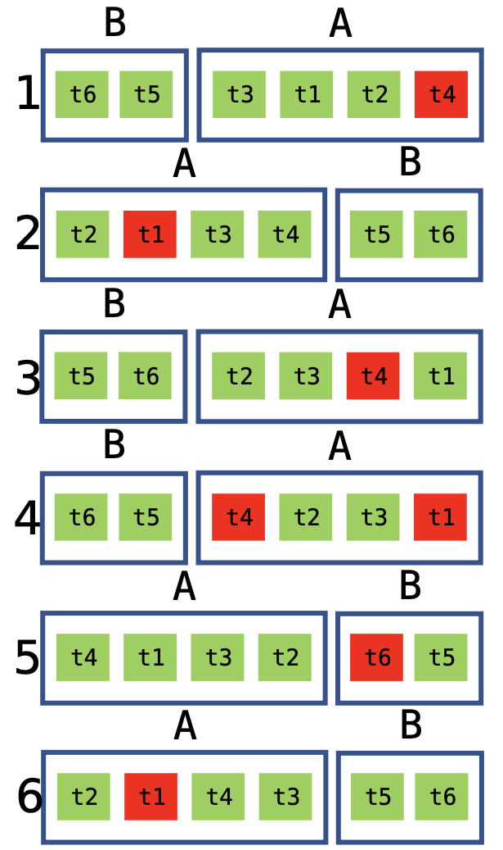
Technique 4: Target Pairs
For 6 tests in 2 test classes:
Greedily produce test-orders that cover all test-pairs that share static fields iteratively
Target Pairs need to be covered:
(t1, t2) (t2, t1)
Runs 6 orders
(t3, t5) (t4, t5) (t2, t6)
(t5, t3) (t5, t4) (t6, t2)

Slide 22
Evaluation
We use a dataset of known OD tests from prior work⁴
categorized OD tests into victims or not, and reported the corresponding polluters/cleaners for the tests
contains 289 OD tests from 47 projects
Subjects used in evaluation
 | # Test |  | # OD Tests
 | Class | Method
Avg. * 2 | Sum. * 1 | 93.9 | 394.3 | 289
⁴Wei et al. “Probabilistic and systematic coverage of consecutive test-method pairs for detecting order-dependent flaky tests.” TACAS 2021.

Slide 23
Research questions
RQ1: Number of test-orders
RQ2: Detected OD tests
RQ3: Cost-effectiveness
RQ4: Minimal test-orders needed

Slide 24
RQ1: Number of test-orders
 | Tuscan Class-Only | Tuscan Intra-Class | Tuscan Inter-Class | Target Pairs
Avg. | 94.0 | 104.7 | 769148.3 | 4167.3
Avg. num. of test orders per technique: Class-Only < Intra-Class < Target Pairs < Inter-Class
Class-Only and Intra-Class have similar number of test-orders => number of test-orders dominated by number of test classes
Inter-Class is expensive but still much less than all possible orders: >10 million for most subjects

Slide 25
RQ2: Detected OD tests
 | Tuscan Class-Only | Tuscan Intra-Class | Tuscan Inter-Class | Target Pairs
Avg. | 36.0 | 97.2 | 100.0 | 89.8
Perc. of OD tests detected per technique: Class-Only < Target Pairs < Intra-Class < Inter-Class
Target Pairs less effective because some OD tests are not OD due to static fields
But some OD tests detected using Target Pairs but not Intra-Class

Slide 26
RQ3: Cost-effectiveness
 | Tuscan Class-Only | Tuscan Intra-Class | Tuscan Inter-Class | Target Pairs
Median (seconds) | 138.8 | 201.7 | 167850.9 | 1962.7
% OD tests detected | 36.0 | 97.2 | 100.0 | 89.8
Median time of running each technique: Class-Only < Intra-Class < Target Pairs < Inter-Class
We recommend running Intra-Class as an effective way to detect OD tests

Slide 27
RQ4: Minimal test-orders needed
Minimal number of test-orders needed to detect all possible OD tests
 | Tuscan Class-Only | Tuscan Intra-Class | Tuscan Inter-Class | Target Pairs
Avg. | 2.0 | 3.4 | 3.3 | 2.9
Minimal number of test orders needed to detect all detectable OD tests per technique:
Minimal num. needed is very small! => Prioritization of test-orders can be effective in helping to detect OD tests efficiently

Slide 28
Conclusion
Systematic detection of OD tests by proposing three new techniques to generate test-orders
Our most practical technique, Tuscan Intra-Class, can detect 97.2% of known OD tests, while running only a few possible test-orders
Future work: prioritize the test-orders with higher chance to detect OD tests
https://sites.google.com/view/systematically-detecting-od

Slide 29
Preempting OD Tests
Preempting OD tests: proactively detecting OD-test failures
Main ways to help developers preempt OD tests:
Run many test-suite orders
All possible test orders
Randomly sample test orders
Systematically pick a subset of orders to run
Using dynamic information
Using static information
Detect tests that may become OD, even if they are currently not
For a test suite with just 5 tests:
Prohibitively expensive for most
T1:
test₀
test₁
test₂
test₃
test₄
T2:
test₁
test₀
test₂
test₃
test₄
Lightweight but may miss OD tests
…
T120:
test₄
test₃
test₂
test₁
test₀
Can contain many false positives

Slide 30
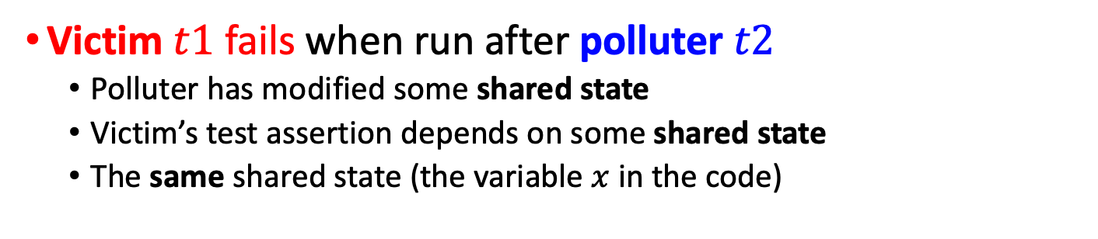
Background: Victim and Polluter
TestOrder1
// shared variable x is initialized to 0 void t1() { assert x == 0; } // victim void t2() { x = 1; } // polluter
t1
t2
TestOrder2
t2
t1
Victim $t1$ fails when run after polluter $t2$
Polluter has modified some shared state
Victim’s test assertion depends on some shared state
The same shared state (the variable $x$ in the code)

Slide 31
In-class exercise
// shared variables x, y, z, w are initialized to 0 void t1() { assert x == 0; } void t2() { x = 1; } void t3() { assert y == 0; } void t4() { z = 1; } void t5() { assert w = 0; w = 1;}
Which tests are flaky?
Which tests can be flaky?
Which tests may create flaky tests?
Which tests may help flaky tests?

Slide 32
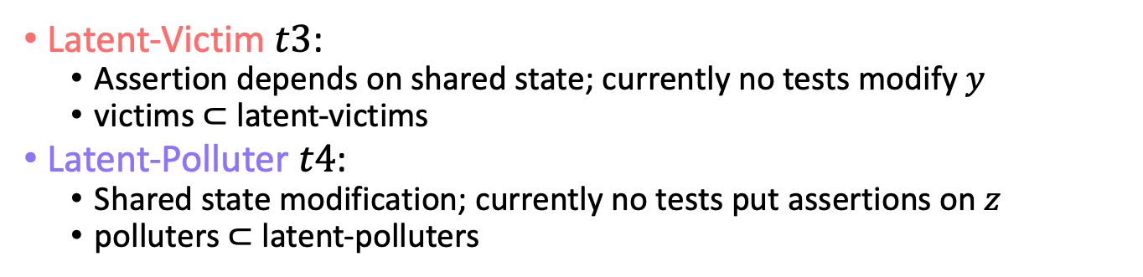
Background: Latent-Victim, Latent-Polluter
// shared variables x, y, z are initialized to 0 void t1() { assert x == 0; } // victim void t2() { x = 1; } // polluter void t3() { assert y == 0; } // latent-victim void t4() { z = 1; } // latent-polluter
Latent-Victim $t3$:
Assertion depends on shared state; currently no tests modify $y$
victims $⊂$ latent-victims
Latent-Polluter $t4$:
Shared state modification; currently no tests put assertions on $z$
polluters $⊂$ latent-polluters

Slide 33
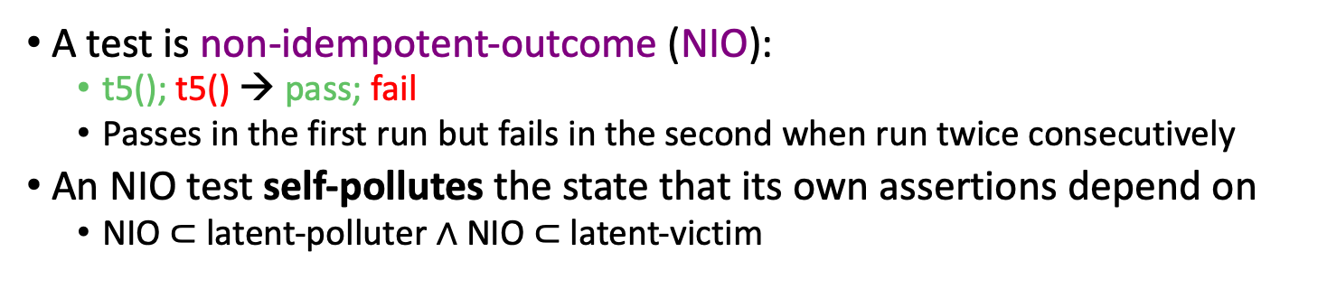
Non-Idempotent-Outcome (NIO) Test
// shared variables x, y, z, w are initialized to 0 void t1() { assert x == 0; } // victim void t2() { x = 1; } // polluter void t3() { assert y == 0; } // latent-victim void t4() { z = 1; } // latent-polluter void t5() { assert w = 0; w = 1;} // NIO
A test is non-idempotent-outcome (NIO):
t5(); t5() → pass; fail
Passes in the first run but fails in the second when run twice consecutively
An NIO test self-pollutes the state that its own assertions depend on
NIO $⊂$latent-polluter $∧$ NIO $⊂$ latent-victim

Slide 34
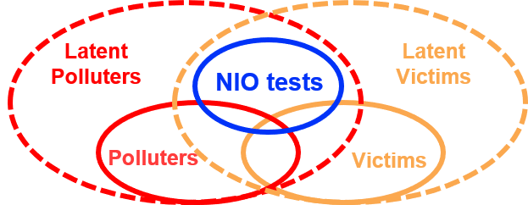
Why should we detect NIOs?
Typically, tests are not run twice
To preempt/prevent flaky tests
Why not fix latent-polluter?
Why not fix latent-victim?
Prior work
Gyori et al.¹ detect 575 latent-polluters
Manually filter 381 (66%) false positives (cannot reasonably become polluters)
Huo and Clause² detect latent-victims with dynamic taint analysis
Do not report how many can reasonably become victims
They do NOT fix any tests
NIOs are more worth fixing
Both latent-victims and latent-polluters at the same time
Easy to detect, no false positives
Well-accepted fixes
¹ Gyori et al., “Reliable testing: Detecting state-polluting tests to prevent test dependency”. ISSTA 2015
² Huo and Clause, “Improving oracle quality by detecting brittle assertions and unused inputs in tests”. In FSE 2014

Slide 35
Agenda
Quiz 4 (please be sure to put your name exactly as it appears on Blackboard -- first name(s) then last name(s), you will lose points otherwise)
Finish lecture on detecting flaky tests
15min break
Lecture on taming flaky tests
Introduce Assignment 4
https://cs.gmu.edu/~winglam/classes/637/assigns/assign04.html

Slide 36
In-class exercise
What are some ways you can think of to help developers deal with flaky tests?
How can you help them fix or deal with (lessen the problems) order-dependent flaky tests?
What are the tradeoffs between the different ways?
What about detecting other categories, such as Network, Concurrency, Async Wait, Unordered Collection?
36

Slide 37
Top Categories of Flaky Tests
2
Causes of Flaky Tests
Order-Dependent
Order-Independent
Async Wait
…
Concurrency
Network
1
FaTB Problem

Slide 38
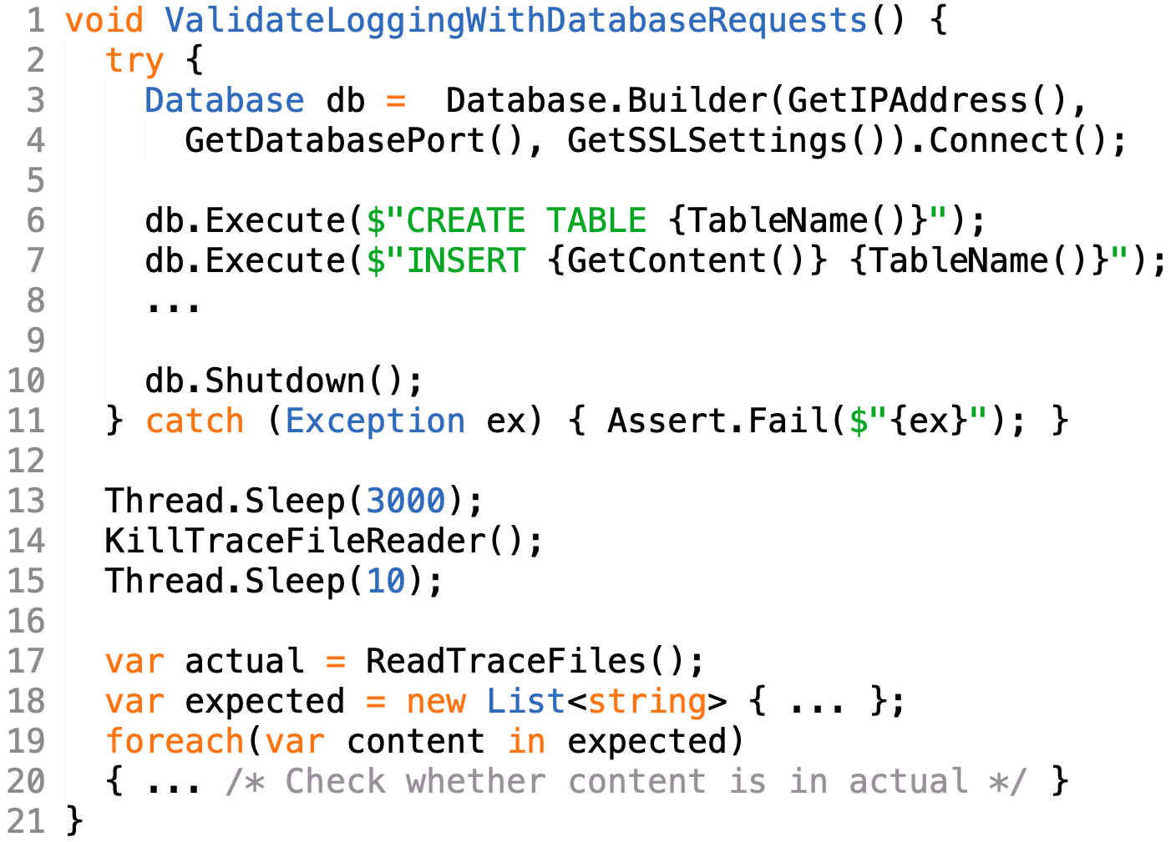
Async-wait Flaky Test Example
Flaky test at Microsoft:
A test is considered flaky if it passes and fails when run in the same test scenario
Test in total contains 100+ lines just in this test class

Slide 39

In-class exercise
Async-wait Flaky Test Example
Flaky test at Microsoft:
A test is considered flaky if it passes and fails when run in the same test scenario
Test in total contains 100+ lines just in this test class
Problem: Line 20 can pass and fail. How come??

Slide 40
Async-wait Flaky Test Content
Flaky test at Microsoft:
Contents of test:
Lines 3-4: Setup database (db)
Lines 6-8: Add content to db
Line 10: Shutdown db
Line 13: ?????????????????? ??????????
Lines 14-15: Ensure file reader is killed before using it
Lines 17-20: Check whether expected content was logged
Why would expected content be missing sometimes?

Slide 41

Async-wait Flaky Test Content
Calls to database are asynchronously logged to trace file!
Flaky test at Microsoft:
Contents of test:
Lines 3-4: Setup database (db)
Lines 6-8: Add content to db
Line 10: Shutdown db
Line 13: Wait for added content to be logged to a trace file
Lines 14-15: Ensure file reader is killed before using it
Lines 17-20: Check whether expected content was logged

Slide 42

Async-wait Flaky Test Patch
Flaky test at Microsoft:
Developer’s patch to reduce flakiness is to increase wait time
Line 13 (3000 -> 6000)
“Fixed flakiness by increasing wait time before checking content” – Developer
Luo et al. [1] categorized such flaky tests as async wait
Async-wait flaky tests make an asynchronous call and do not properly wait for the call to return
[1] Q. Luo et al. An Empirical Analysis of Flaky Tests. In FSE’14.

Slide 43
In-class exercise
Flaky test at Microsoft:
How should developers tame the problems of Async-wait flaky tests?
How would you fix this flaky test? Can you produce multiple ways to fix it?
Async-wait flaky tests make an asynchronous call and do not properly wait for the call to return

Slide 44
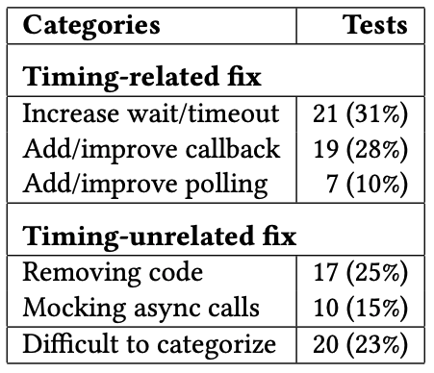
How Developers Tame Async-Wait Tests
Fowler [1] proposed three ways to tame async-wait issues;
Creating “synchronous” interface (0%)
Implementing callback (28%)
Implementing polling (10%)
Besides what Fowler proposed, I find three other ways for Microsoft developers;
Increasing wait/timeout (31%)
Removing the code (25%)
Mocking the async calls (15%)
Timing-related patches
Timing-unrelated patches
* Does not sum to 100% because 1 test can be in 1+ categories
[1] M. Fowler. Eradicating non-determinism in tests. https://martinfowler.com/articles/nonDeterminism.html

Slide 45
Agenda
Quiz 4 (please be sure to put your name exactly as it appears on Blackboard -- first name(s) then last name(s), you will lose points otherwise)
Finish lecture on detecting flaky tests
15min break
Lecture on taming flaky tests
Introduce Assignment 4
https://cs.gmu.edu/~winglam/classes/637/assigns/assign04.html

